Slide 1

Graduate Admission
The Analysis and Prediction of Graduate Admissions using Python language
Echo Liu

Slide 2


Let’s meet Sarah Wu, a senior student in HongKong University
What are the key requirements when applying for UCLA Masters?
What are the chances to enter my dream school, UCLA?
How to enhance the probability of UCLA Master’s acceptance?
Notes:
Good morning, we are glad to be here to present the analysis and prediction of graduate admission using python programming language.
Before start, allow me to introduce a friend of mine, her name is Sarah Wu, she is a senior student in HongKong University majoring in film director and business management. She has spent her three years in HongKong University and is planning to study abroad for her master degree. She has a dream to spend some time in California and UCLA is her favorite school not only because of the location, but also the reputation of filming majors. However, she is facing some concerns when she plans to apply for UCLA masters: as an international student, she did not know the key requirements if she applies for UCLA Masters, what is the estimate possibility to enter her dream school to provide a prediction and how to enhance the probability?

Slide 3



Main Purpose
Solving Sarah’s concerns of applying UCLA Master Program becomes our mission
Key Factors
Analyzes the important factors of getting accepted by UCLA Master Program
Prediction
Predicts and estimates the possibilities of being accepted by particular university
Enhancement
Helps Sarah in increasing the possibilities of been accepted by UCLA Master’s
Requirement List
Predict possibilities
Enhancement
Notes:
Solving Sarah’s three concerns of apply UCLA Master program becomes our main focus that from a data analytic perspective, there are three steps we need to conduct: first, analyzes the important factors of getting accepted by UCLA Master Program to generate a requirement list; secondly, predicts and estimates the possibilities of being accepted by particular university like UCLA, and thirdly, helps Sarah to enhance the possibilities of been accepted by her dream school, UCLA Masters.

Slide 4

Data Introduction
Dataset inspired by UCLA Graduate dataset
Key parameters
9 Columns:
Serial No.
GRE Score
TOEFL Score
University rating
SOP
LOR
CGPA
Research
Chance of Admit
GRE Scores ( out of 340 )
TOEFL Scores ( out of 120 )
University Rating ( out of 5 )
Statement of Purpose ( out of 5 )
Letter of Recommendation Strength ( out of 5 )
College GPA ( out of 10 )
Research Experience ( either 0 or 1 )
Chance of Admit ( ranging from 0 to 1 )
400 Rows
https://www.kaggle.com/mohansacharya/graduate-admissions/home
Mohan S Acharya, Asfia Armaan, Aneeta S Antony : A Comparison of Regression Models for Prediction of Graduate Admissions, IEEE International Conference on Computational Intelligence in Data Science 2019
Notes:
Now, we are introducing our dataset, inspired by the UCLA graduate dataset. There are 9 columns as follows: serial number which indicate the order of each string, GRE score out of 340, TOEFL scores out of 120, University rating out of 5, statement of purpose out of 5, letter of recommendation strength out of 5, college GPA out of 10 ( this is the old format of HongKong University), research experience ( 0 is no experience whereas 1 has some experience, lastly the chance of admit ranging from 0 to 1 as percentage. Besides Serial Number, all of the eight columns in dataset are the variables and there are 400 rows in the dataset.

Slide 5
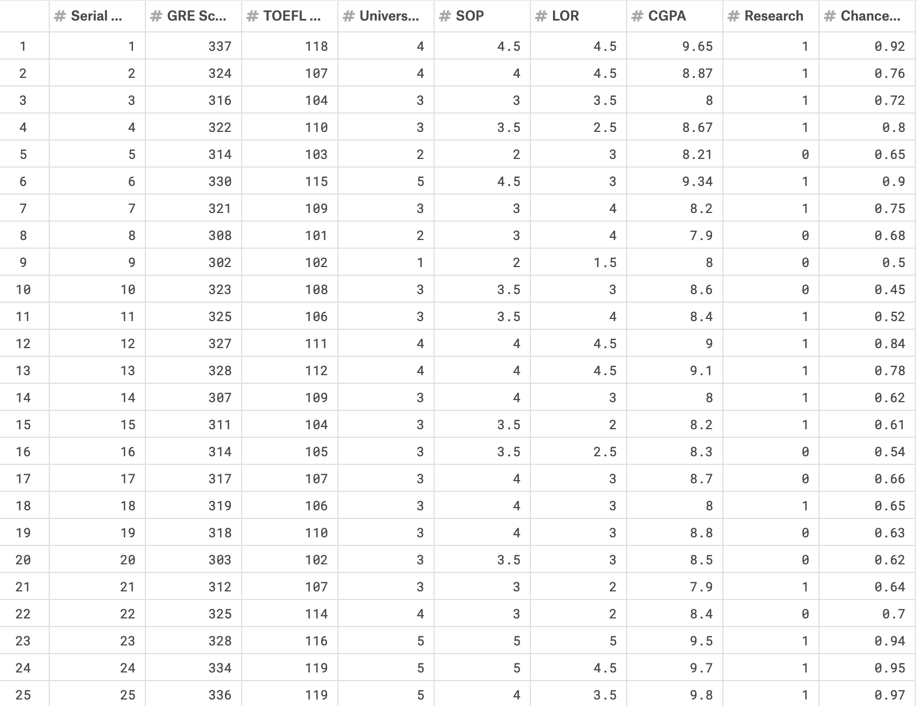
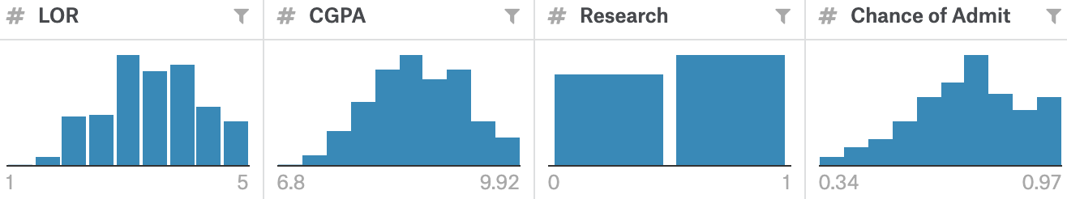
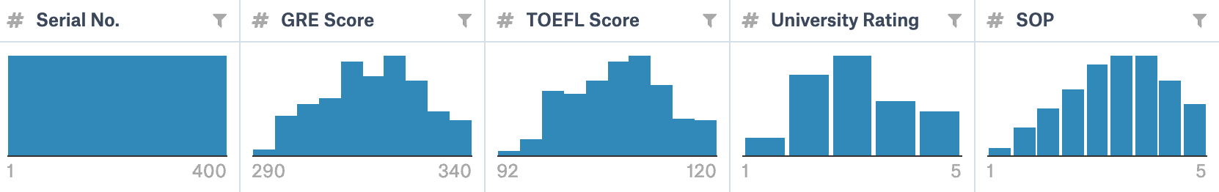
Dataset View
Notes:
We will talk about the distribution of each variable later

Slide 6





Data Analysis
The aim of data analysis is to conduct a wide variety of analysis and forecasting operations using the dataset.
Dataset Overview
Imports libraries and reads the dataset to obtain the basic information
Inspect Dataset
Inspects the dataset by removing missing value and updating all numeric values to two decimals
Data Visualization
Visualizes the distribution of each variable and the correlation between different parameters
Data Modeling
Takes advantages of algorithms including Linear Regression, Random Forest and Decision Tree
Notes:
Here comes to the main part, data analysis. The aim of data analysis is to conduct a broad variety of analyzes and forecasting operations using the dataset. There are four steps: dataset overview, we import libraries and read the dataset to get a big picture and the basic information about this dataset; dataset inspection, we inspect the dataset by removing missing value and updating all numerical values to two decimals for easy to read. Data visualization, visualizes the distribution of each variable and the correlation between different parameters. Lastly, Data modeling, we take advantages of algorithms including linear regression, random forest and decision tree to get the desired results.

Slide 7
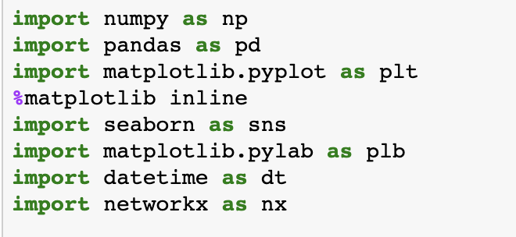
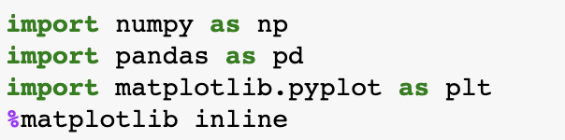
Library Installation
Numpy: Provides multi-dimensional array object
Pandas: Python Data Analysis Library
Matplotlib: Python 2D Plotting Library
Seaborn: Python Data Visualization Library
Datetime: Supplies classes for manipulating dates and times
Networkx: Python Library for studying graphs and networks
Notes:
For data overview, we installed some essential libraries: numpy to provide multi-dimensional array object; pandas as python data analysis library, Matplotlib as python 2D plotting library, seaborn for data visualization, datetime for manipulating dates and times, and Networkx to study graphs and networks.

Slide 8
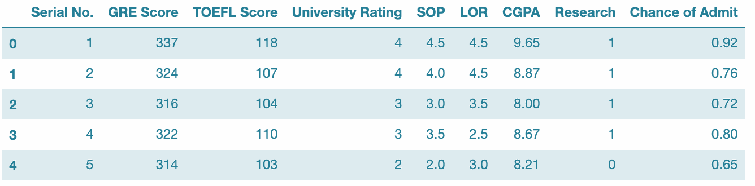
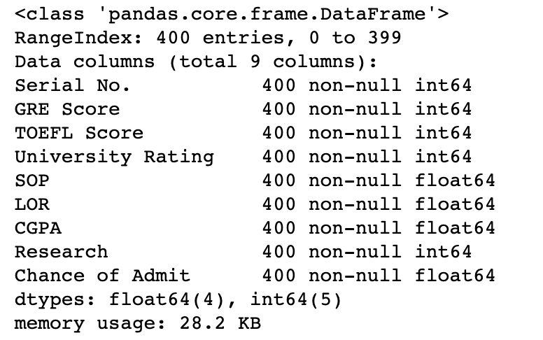
Dataset Inspection
Check variable types, numeric statistics and
categorical variable frequencies
Use data.head( ) to check the first 5 rows

Slide 9
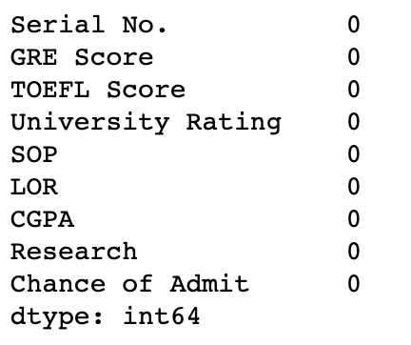
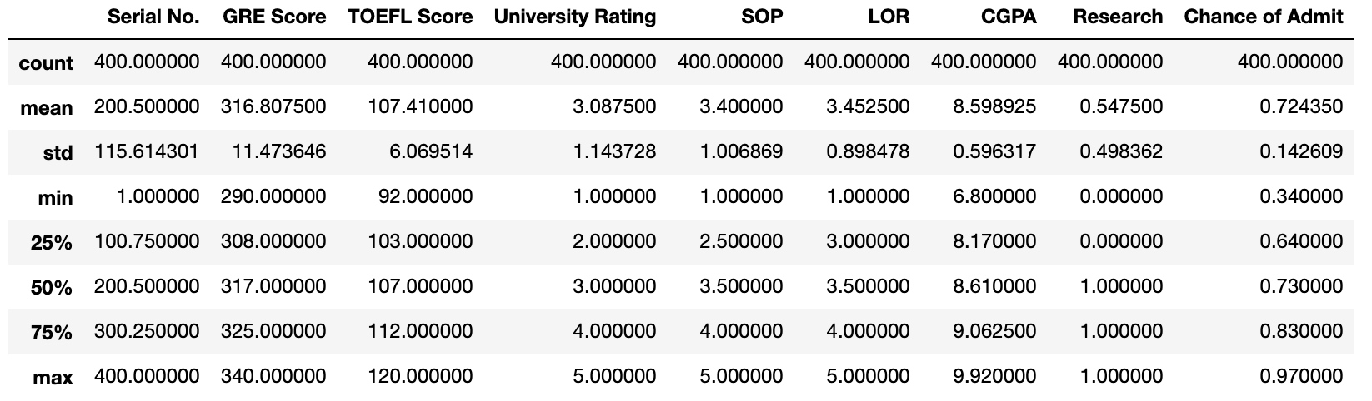
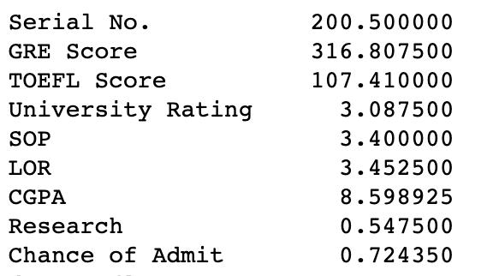
Dataset Inspection
Check the Null Data
Check the Outliers
Get the Mean Value

Slide 10
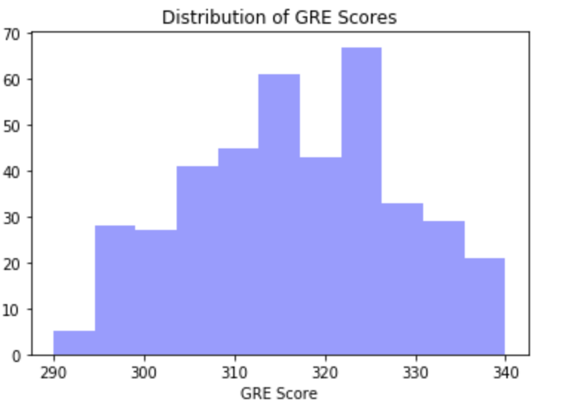
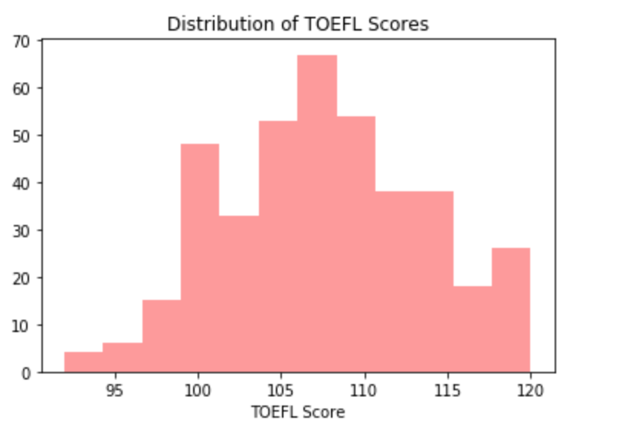
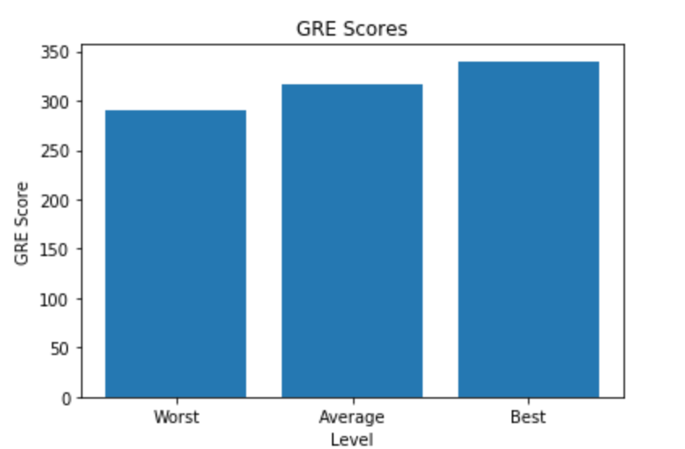
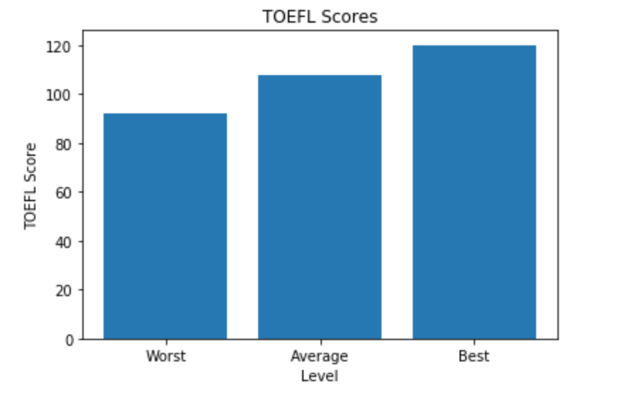
Distribution of GRE and TOEFL Scores
Distribution of GRE Scores
Distribution of TOEFL Scores

Slide 11
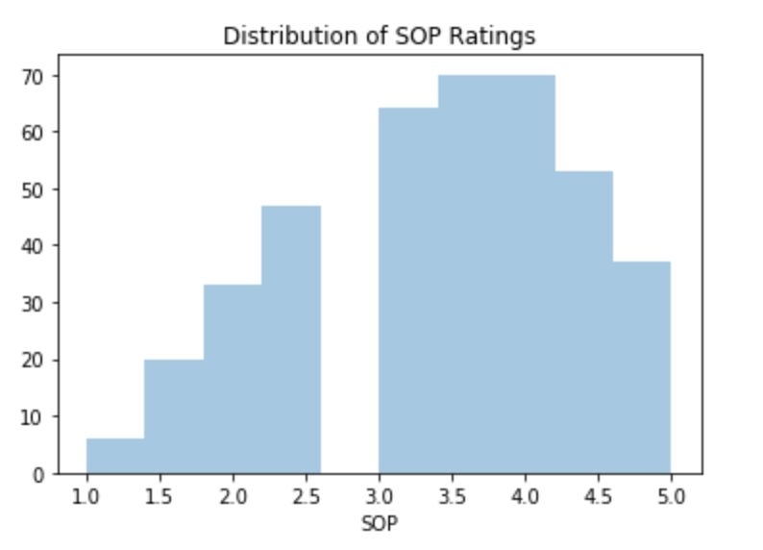
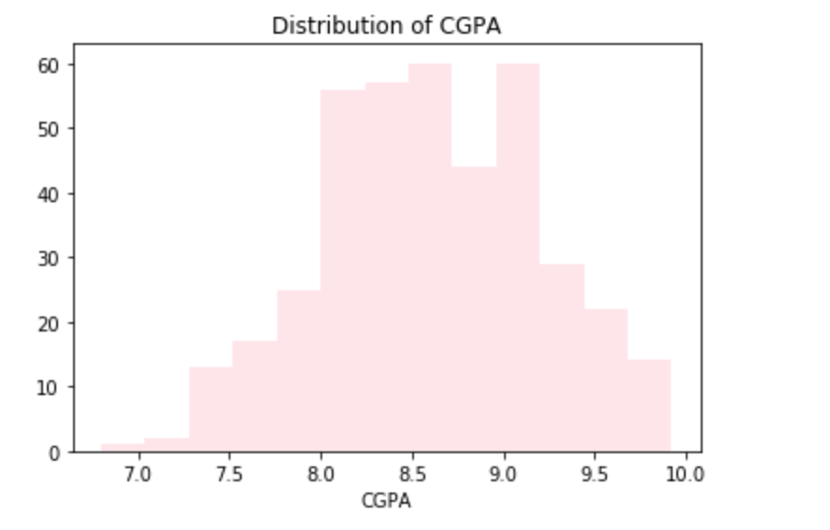
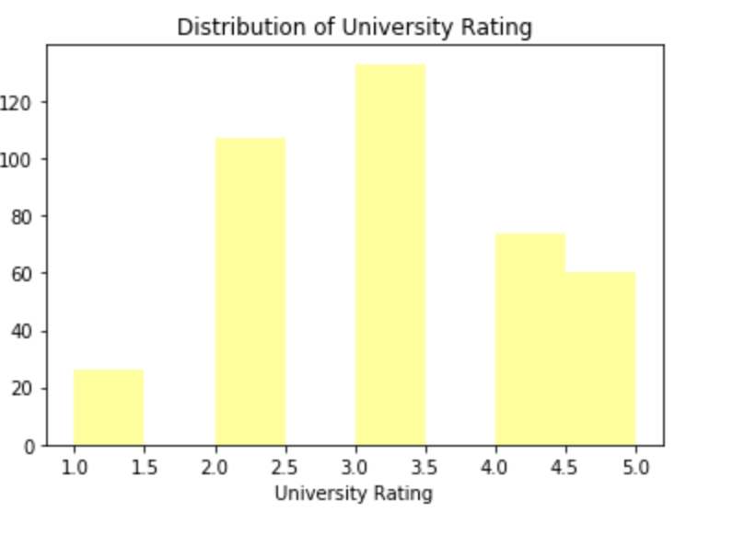
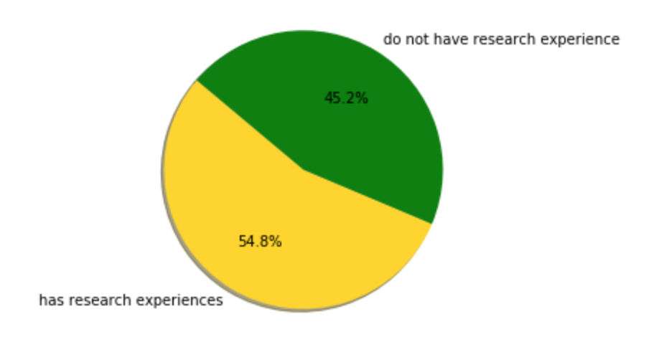
Distribution of Other Variables
Distribution of SOP ratings
Distribution of CGPA
Distribution of University Rating
Distribution of Research Experience

Slide 12
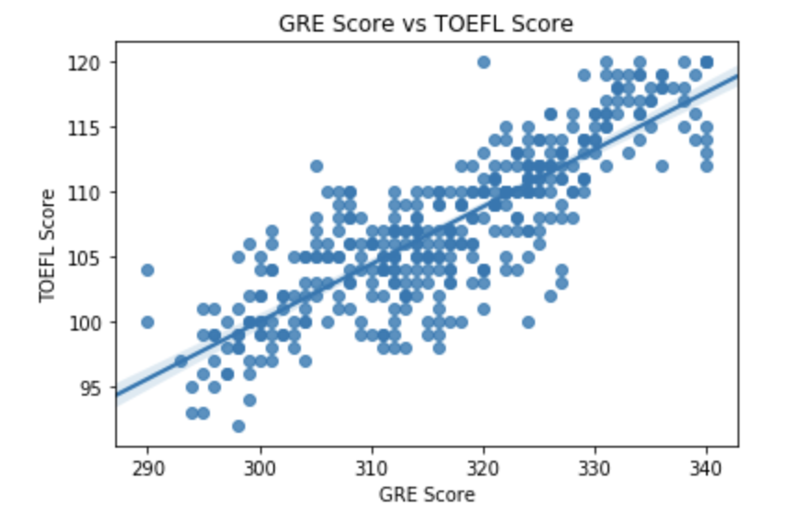
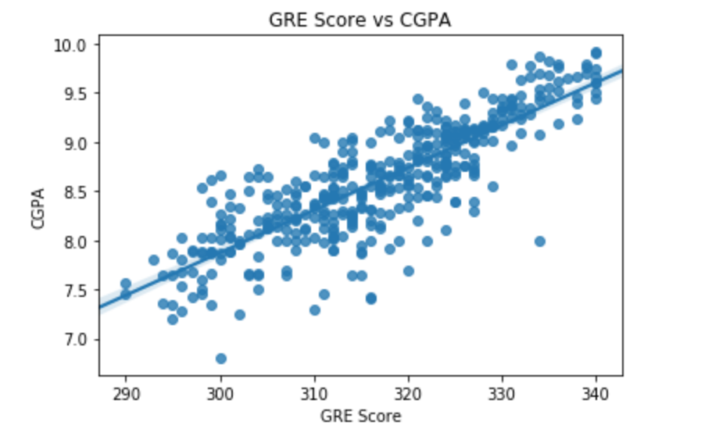
Correlations Between Variables
Correlation between GRE and TOEFL Scores
Correlation between GRE and CGPA

Slide 13
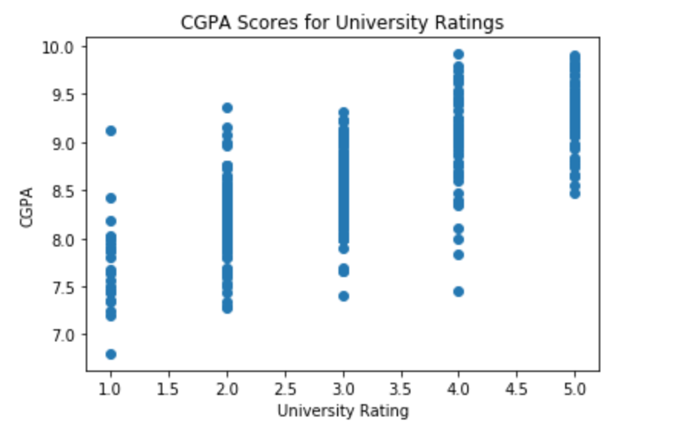
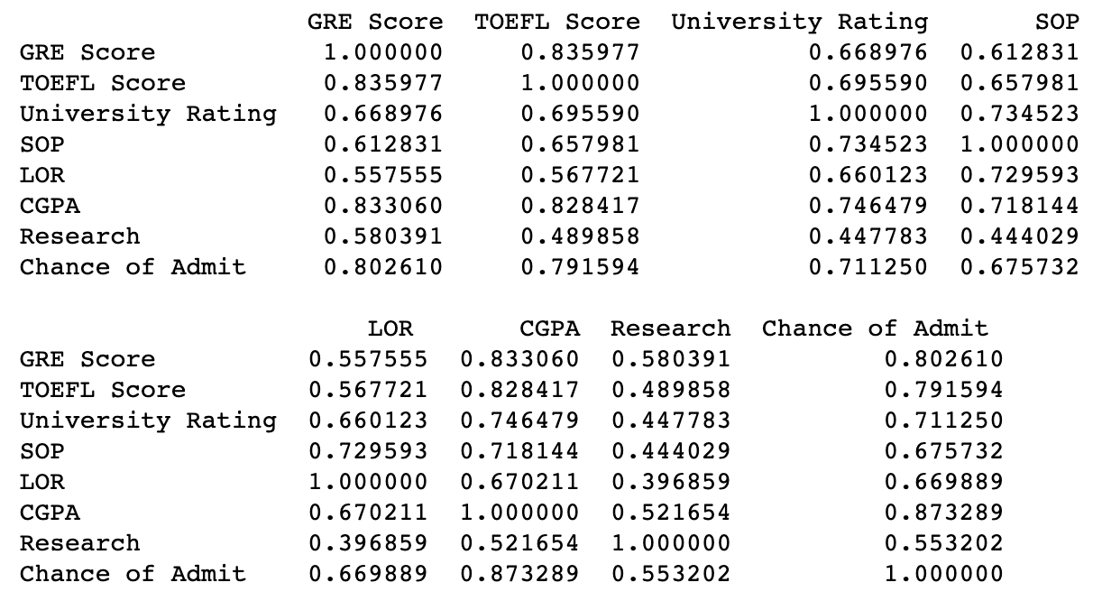
Correlations Between Variables
Correlation between CGPA and University Rating
Correlation between All Variables except Serial No. Column

Slide 14
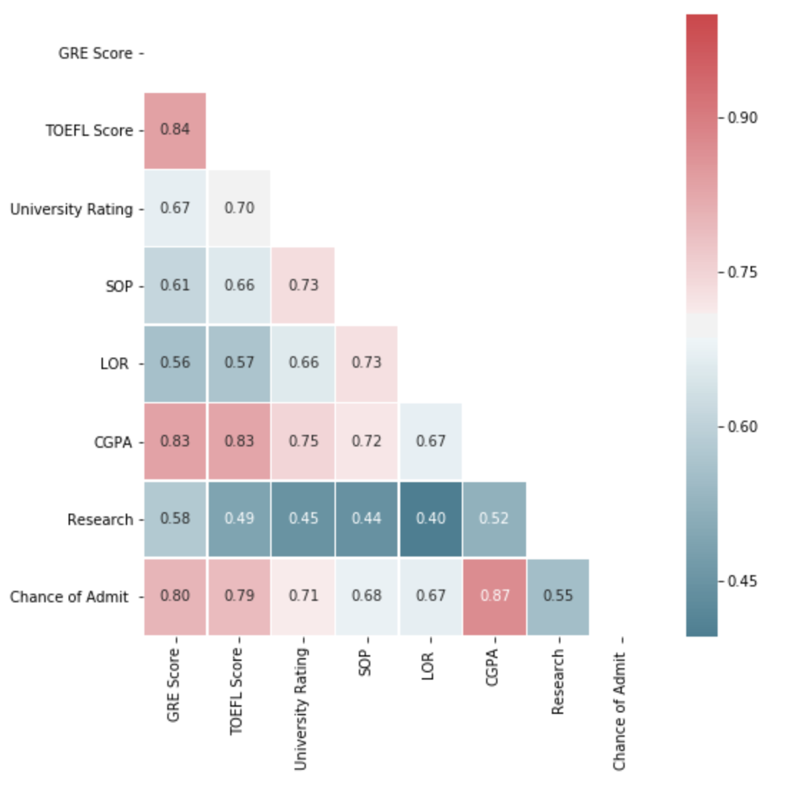
Correlation Matrix
We can clearly see that some variables are highly correlated while some are not, variables that are highly correlated are:
TOEFL Score and GRE Score
CGPA and GRE Score
CGPA and TOEFL Score
Chance of admit and GRE score, TOEFL score, and CGPA

Slide 15



Assessing the Fit of Regression Models
R2 Score
How close the data are to the fitted regression line.
R-squared is always between 0 and 100%:
0% -------------------------------------------------100%
Mean Squared Error
Error means the difference between the observed values y1, y2, y3, … and the predicted ones pred(y1), pred(y2), pred(y3)...
lower is better:
low----------------------------------------------higher

Slide 16
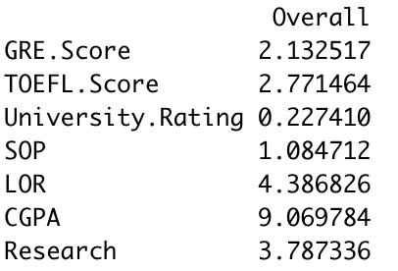
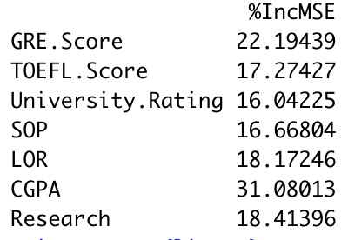
Data Modeling
Linear Regression
Random Forest
r square score (train dataset): 0.821
mean squared error(train dataset): 0.060
r square score(test dataset): 0.744
mean squared error(test dataset): 0.069
r_square score (train dataset): 0.976
mean_squared_error(train dataset): 0.022
r_square score(test dataset): 0.797
mean_squared_error(test dataset): 0.062

Slide 17
Data Modeling
Decision Tree Regression
r_square score (train dataset): 1.0
mean_squared_error(train dataset): 1.5202354861220293e-17
r_square score(test dataset): 0.800
mean_squared_error(test dataset): 0.071

Slide 18
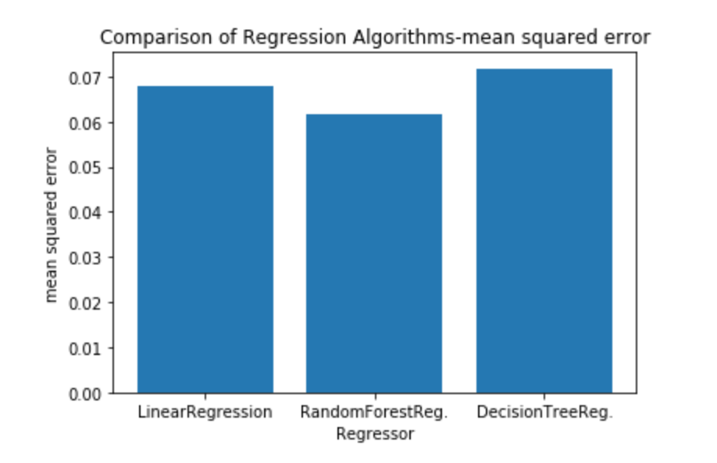
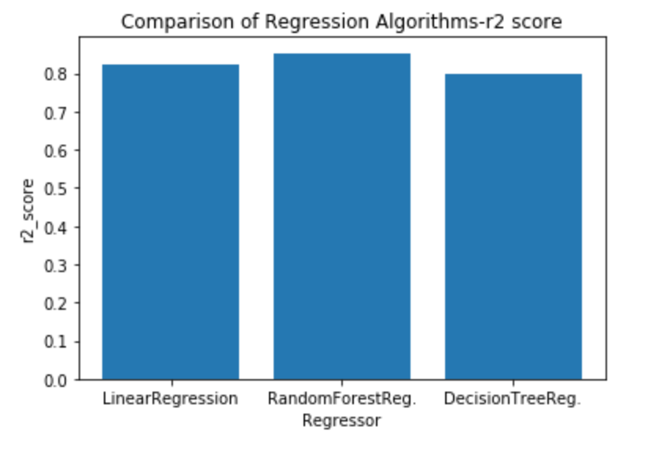
Comparison of Data Models
We have compared regression algorithms and have conducted that Linear Regression and Random
Forest Regression algorithms were better than Decision Tree Regression.

Slide 19
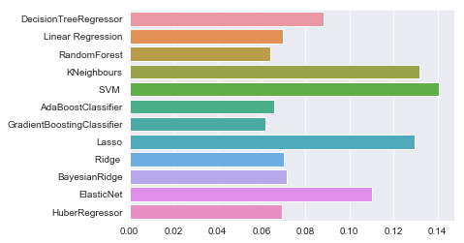
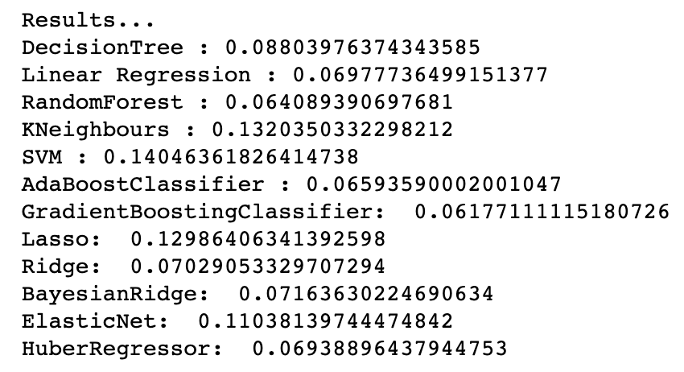
Comparisons of other models

Slide 20
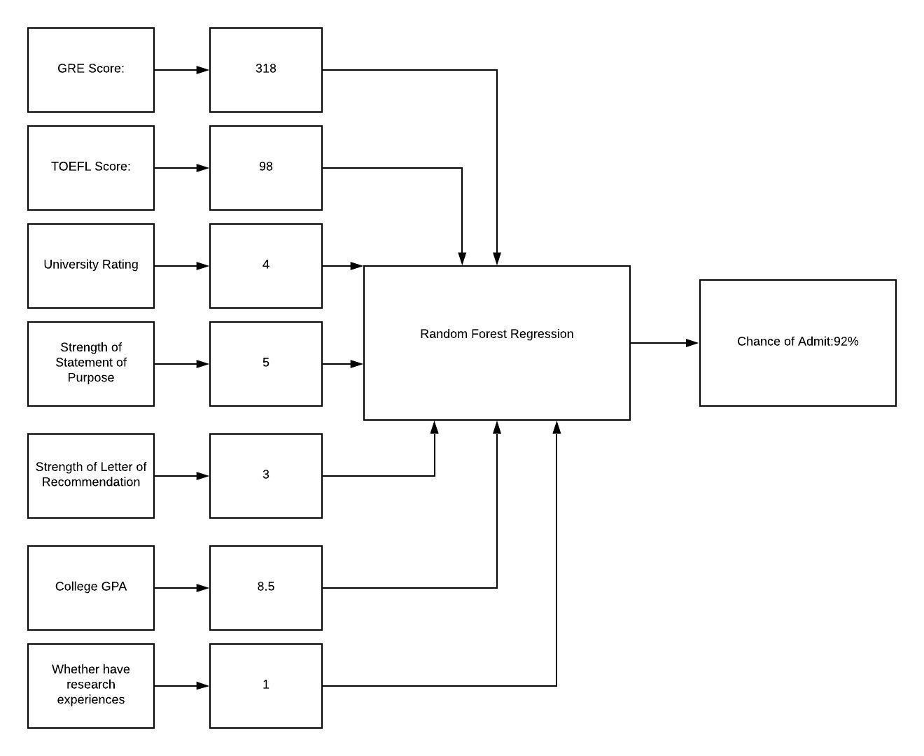

Possibility Prediction
GRE Score: 318
TOEFL Score: 98
University Rating: 4
Strength of Statement of Purpose: 5
Strength of Letter of Recommendation: 3
College GPA: 8.5
Research Experience: 1
Data Model: Random Forest Regression
Chance of Admit: 92%

Slide 21
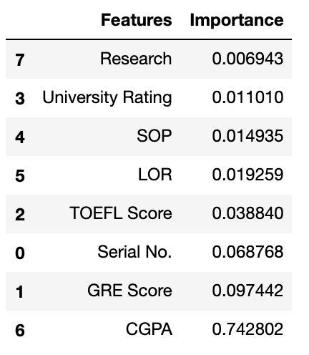
Feature Importance
We found CGPA is the most factor for graduate admissions followed by GRE Score.

Slide 22
Summary
Solving Sarah Wu’s concerns of applying UCLA Master Program by Data Analytics
GPA
is the most important factor to apply UCLA Master’s program
92%
is the possibility rate of Sarah to enter her dream school, UCLA
GRE
Improving GRE and TOEFL scores will increase the possibility of entering UCLA Master’s

Slide 23
THANK YOU

